Slide 1
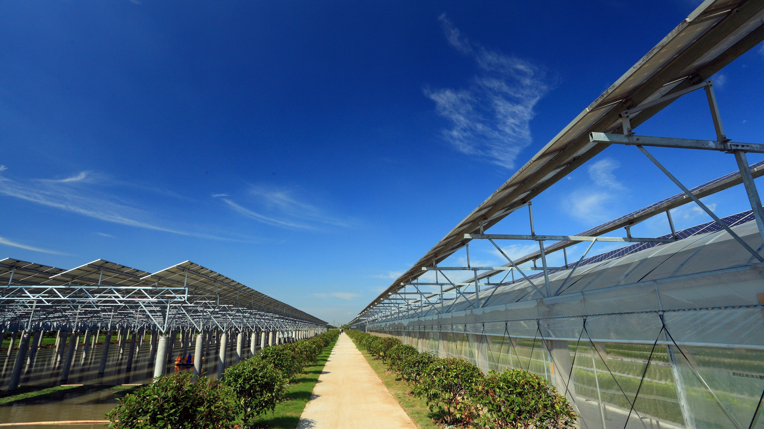

Talesun
The First Brand of Agricultural PV
www.talesun.com
sales@talesun.com

Slide 2

Contents
01
Talesun - Company Profile
02
Talesun - Introduction to Agricultural PV
03
Talesun - Agrivoltaics Projects

Slide 3
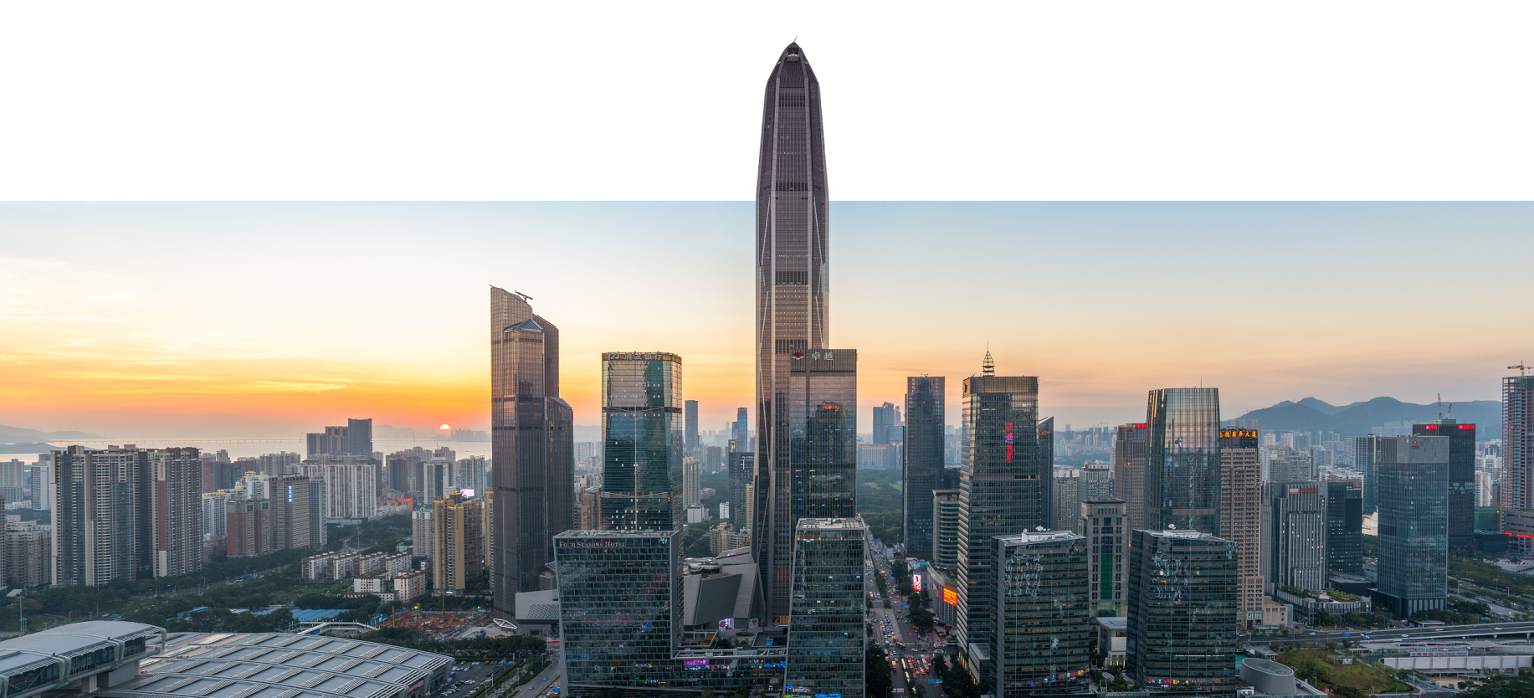

About Talesun
World's Top 10 leading PV solar cell and module manufacturer and agriculture renewable energy solution provider.
6
Global Production Bases
36 GW+
Accumulative Shipments
80+
Shipped Countries
TOP10
Top 10 Suppliers of Distributed PV Modules
TOP 10
China's Top 10 Independent Innovation Enterprises
TOP 20
BNEF’s PV module bankability
No. 1
PV + Agriculture Project Provider in China
TOP 10
PV Project Development & EPC Company in China
TOP 50
Global New Energy Enterprise
$450M
R&D Investment
210+
R&D Team Members
600+
Patents Applied

Slide 4
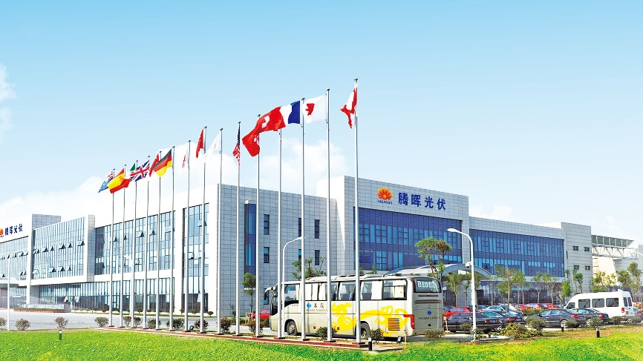
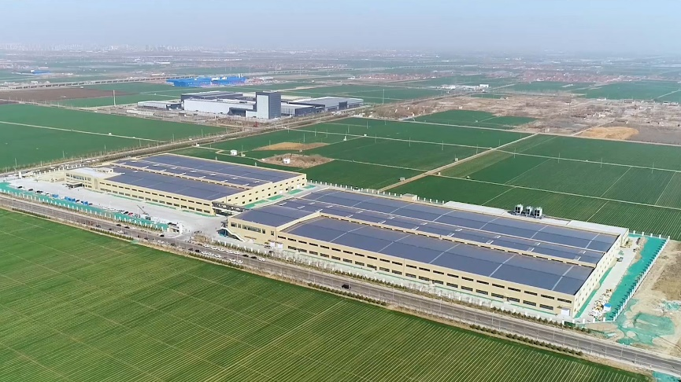
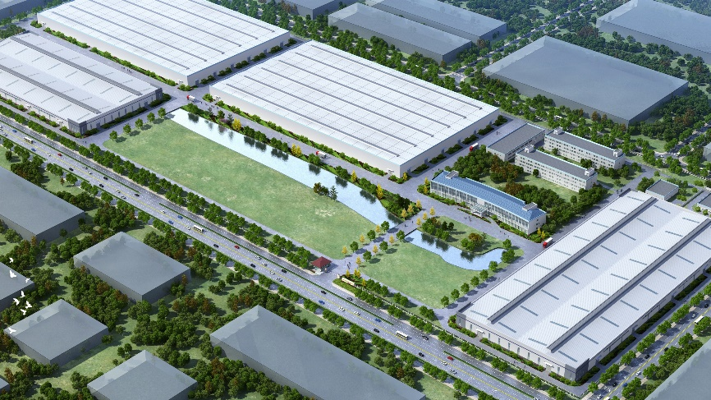
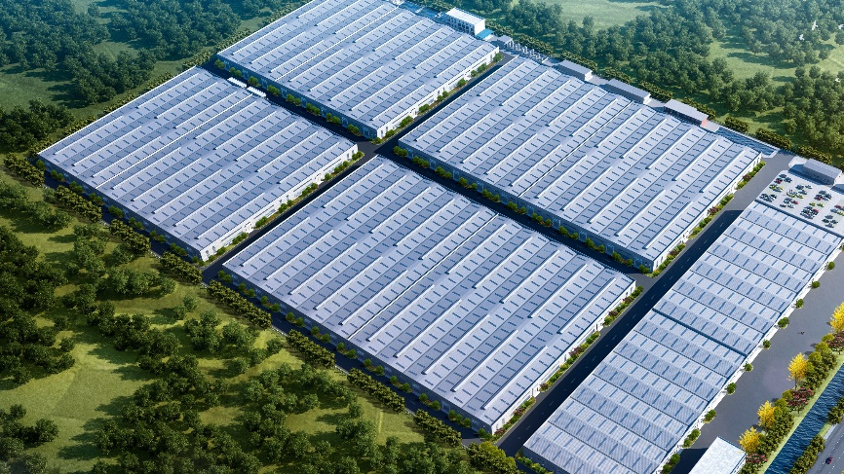
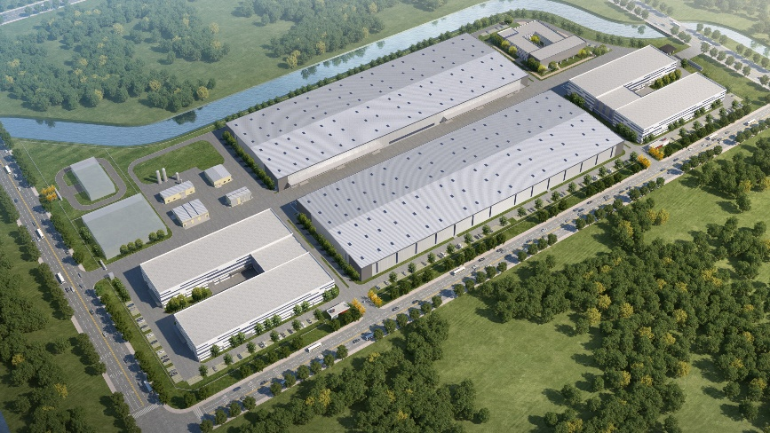
R&D and Production Bases （China）
Changshu, Jiangsu
Zibo, Shandong
Siyang, Jiangsu
Suqian, Jiangsu
Peixian, Jiangsu

Slide 5
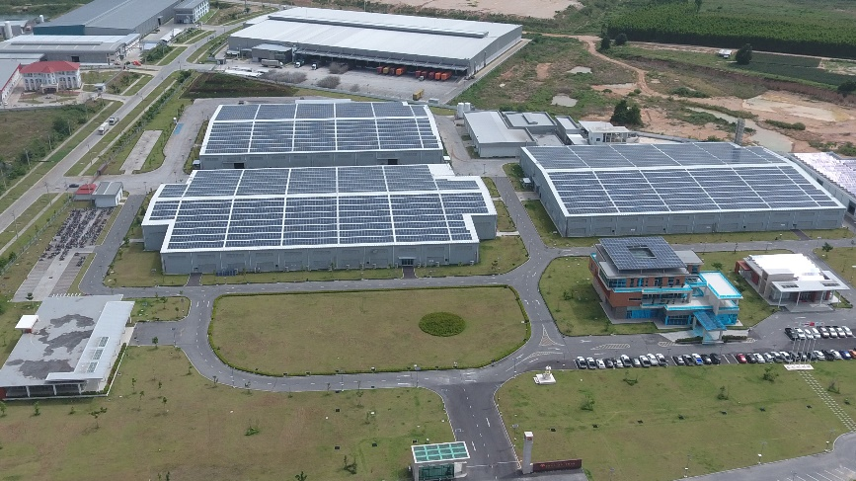
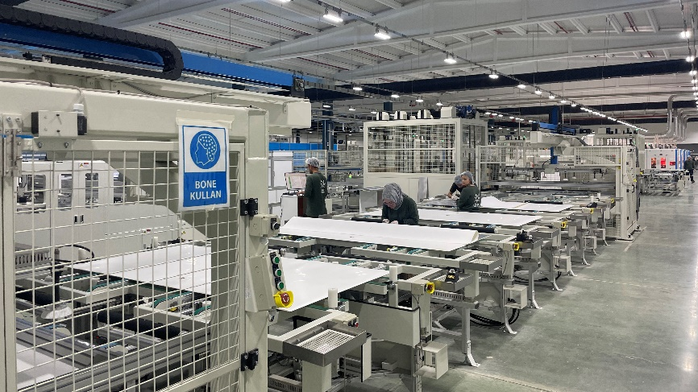
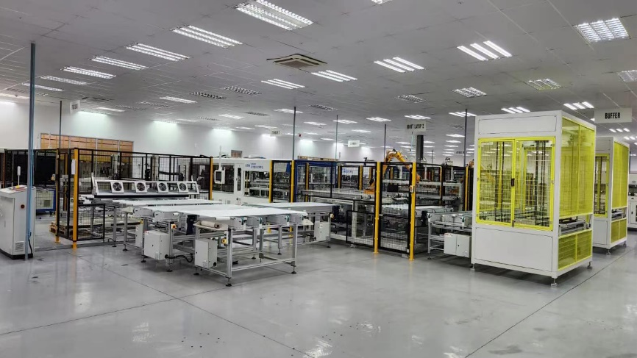
R&D and Production Bases（Overseas）
Rayong, Thailand
Qahraman Marash, Turkey
Durban, South Africa

Slide 6


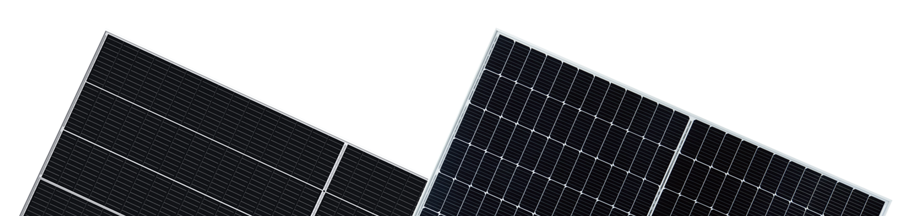
More Efficiency, Higher Capacity
Talesun Productions
Flexible Module Production Capacities
16GW Cells
20GW Modules

Slide 7
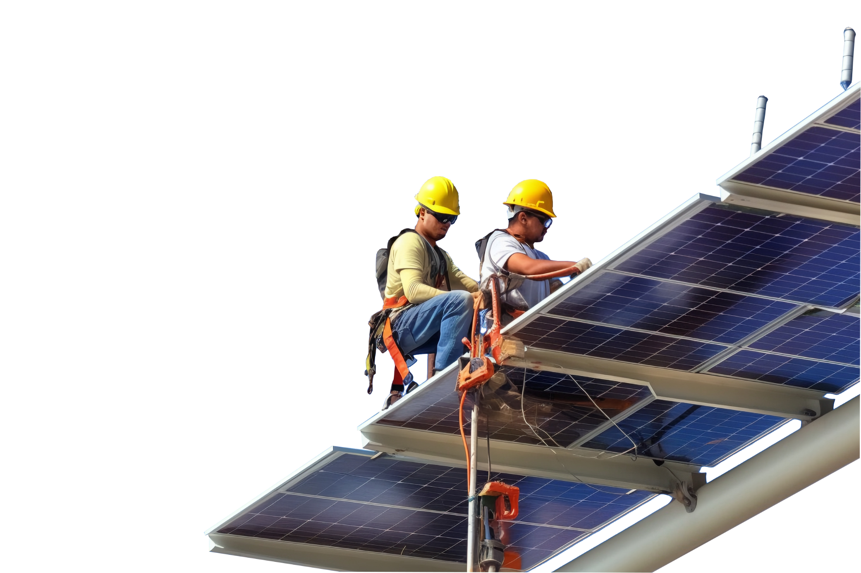
Reliable Project Development
An Experienced Partner
Knows What You Need
With its comprehensive professional knowledge and rich experience, Talesun has developed a reasonable development process to ensure that each PV project is commenced and completed as scheduled.
Reliable Track Record
15 GW PV project development experience
Global sales and project development network
Flexible and Professional Project Development
Professional localization project development team
Efficient management based on rich experience in project development
Flexible development models including project planning, independent development and cooperative development
High-Quality Project Pipeline
Close partnership with leading developers around the world
High-quality project development team and rich project pipeline

Slide 8




Excellent Project Engineering Design Capabilities
Excellent Engineering Design Capabilities
Strict Standards and Tailor-made Services
Professional Engineering Design and High-efficiency Team
High standards are implemented throughout the project engineering design to ensure project quality.
Project layout design is based on factors such as actual solar radiation, weather and site conditions.
Tailor-made solar energy solutions based on project characteristics
The most optimized engineering design based on demands of customers
Talesun adopts industry-leading PV project design tools.
Talesun provides customers with the best solar energy solutions based on data from professional platforms.
Respond quickly and make timely adjustments through teamwork.
Experienced
Engineering Team
Rich
Solution Package
Professional
Industrial Standards
Leading
System Design

Slide 9
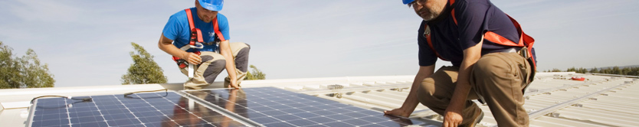
High-efficiency Construction Management
Rich Experience of PV Project Construction
Talesun has an experienced construction management team with EPC qualification for power engineering. By improving project construction management process, Talesun has been building PV projects efficiently, and optimizing construction costs and LCOE.
Strict Execution Plan & Management
Professional and experienced Team
Efficient team management ensures that every project of Talesun is completed on time
Accelerate installation and reduce labor costs by improving construction processes
Maximize power output throughout the life cycle of PV projects
Rich experience in PV project construction management and proprietary technology in PV industry
World-class PV project construction capabilities and top project operation management team

Slide 10
Contents
01
Talesun - Company Profile
02
Talesun - Introduction to Agricultural PV
03
Talesun - Agrivoltaics Projects

Slide 11
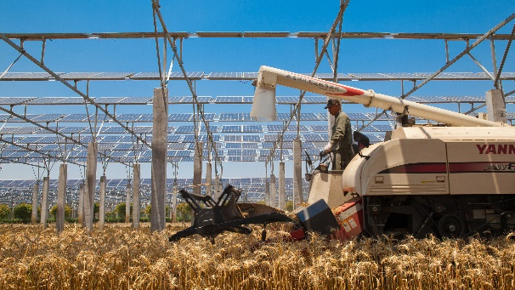
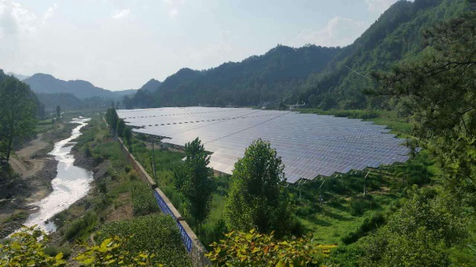
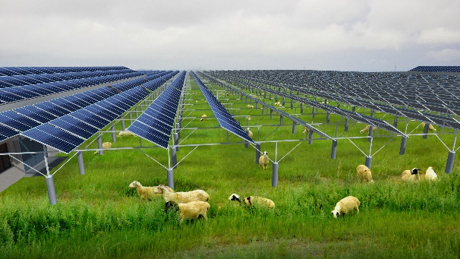
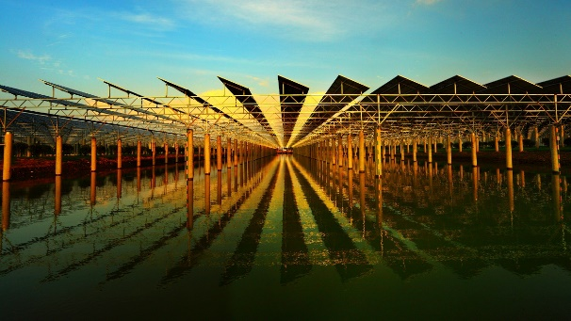
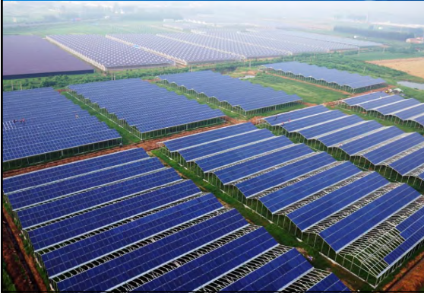
Talesun Introduction to Agricultural PV
Multiple Types of PV + Agriculture
Agri-voltaics
Forestry Agri-voltaics
Animal Husbandry
Agri-voltaics
Fishery Agri-voltaics
PV+Other

Slide 12
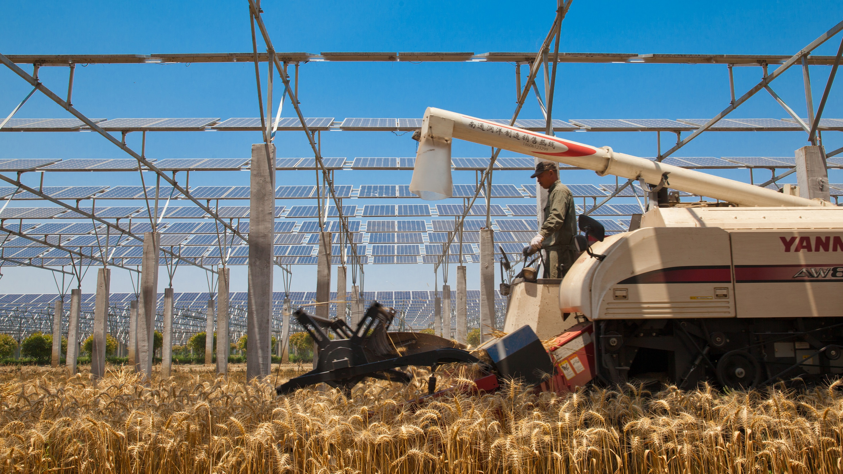
Agri-voltaics
Combining PV power generation with agricultural industries can help decarbonize agriculture and increase production and efficiency while fully developing and utilizing solar energy.
·

Slide 13

Forestry Agri-voltaics
According to different geographical environments, the combination of large-scale afforestation and photovoltaic power generation has effectively improved geological conditions and significantly increased the comprehensive benefits of land use.
·

Slide 14
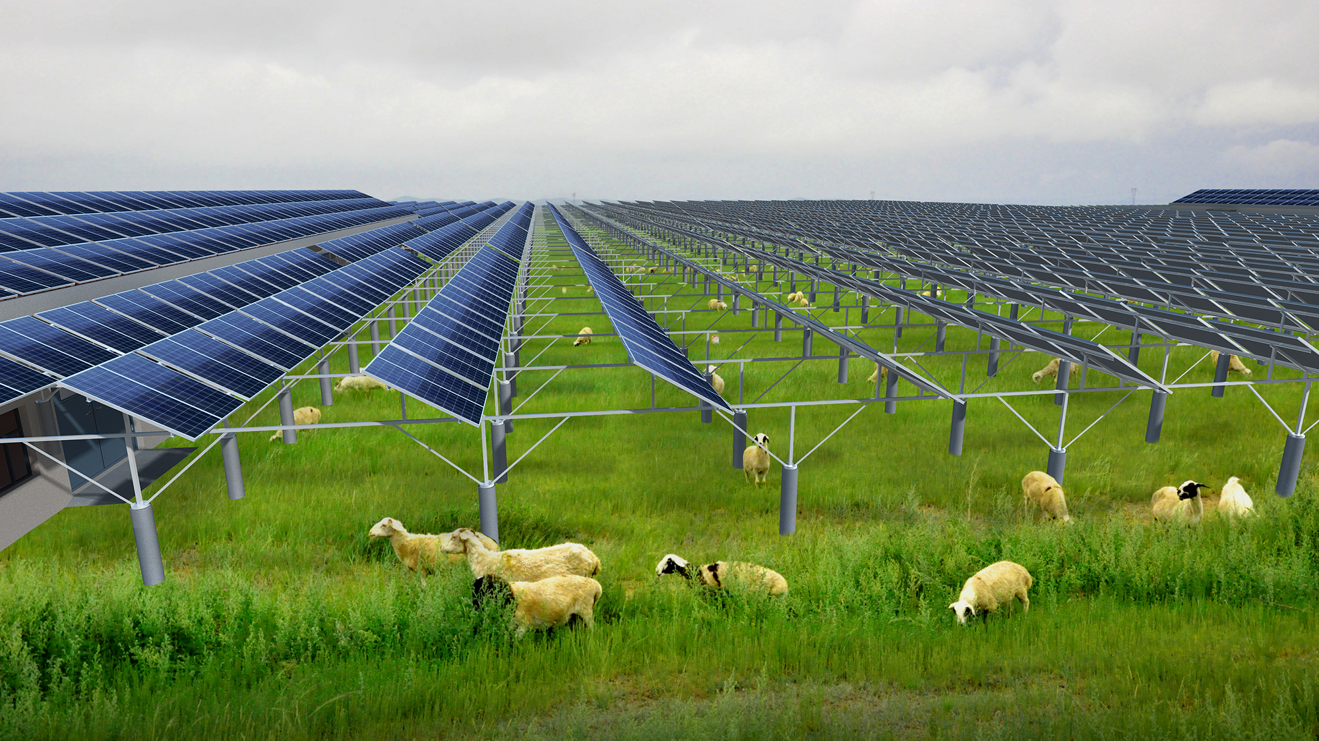
Animal Husbandry Agri-voltaics
PV power generation is deployed in farm construction, and modern biotechnology, information technology, new materials and advanced equipment are used to achieve the integration and innovation of ecological husbandry and circular agriculture technology models, providing strong technical support for the sustainable development of animal husbandry.

Slide 15
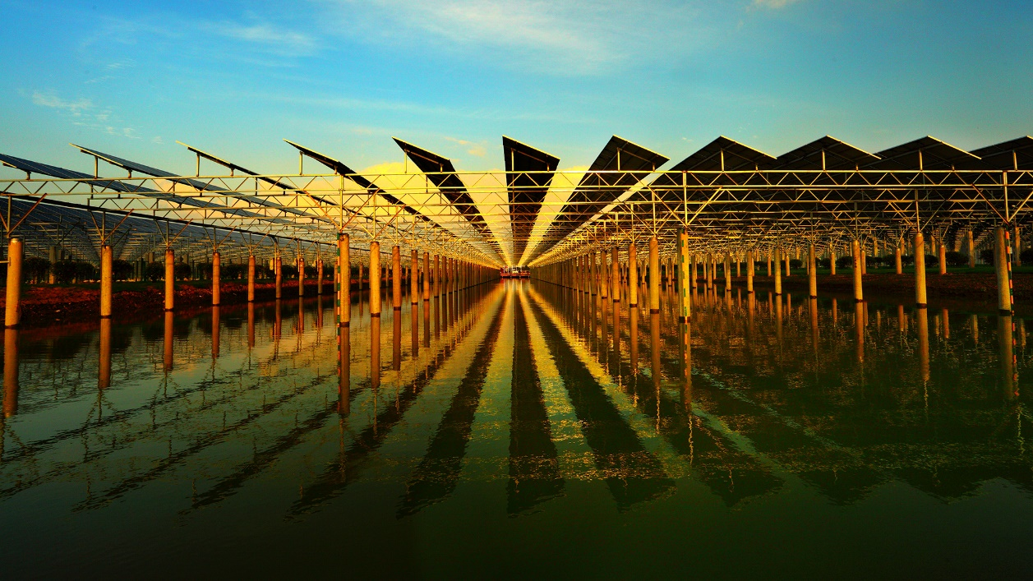
Fishery Agri-voltaics
Combining fisheries with PV power generation, solar arrays are erected above the water surface of the fish pond while fish and shrimp aquaculture are carried out in the water below. The arrays provide good shelter for aquaculture.

Slide 16
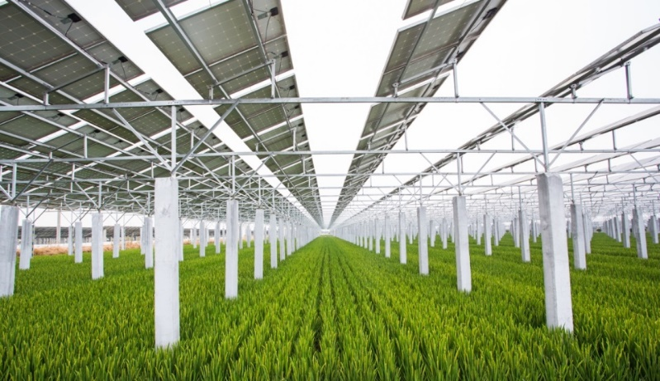
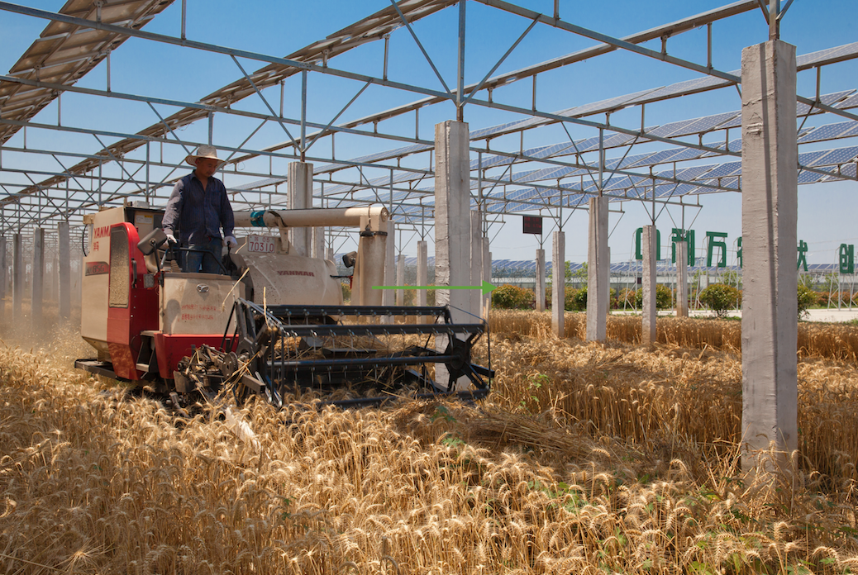
Innovative Technology of Agricultural PV Industry
Innovate the mechanization of PV agriculture： It raises the height of PV modules to more than 4 meters, and expands the span of PV support piles to 10 meters to meet the requirements of mechanized farming and agricultural lighting conditions, and ensure the realization of superimposed income of "intelligent photovoltaic + characteristic agriculture".
Innovate the comprehensive utilization rate of land： roads, water channels and equipment rooms are all placed under the PV panels. While a 100MW traditional PV power plant project needs to cover an area of more than 3,000 mu, the PV farm innovation project covers an area of less than 2,000 mu, saving more than 40% of land and reducing land costs.
Innovate the component panel installation and inclination technologies： It makes the solar illumination rate reach more than 70%, enabling large-scale planting of rice, wheat and corn. This innovative technology was inspected by technical experts of the Chinese Academy of Agricultural Sciences at the PV farm rice project site, and the rice yield per mu yield reached 602.1 kg, which is higher than other rice yields per mu in the region. Characteristic agriculture can achieve higher yield.

Slide 17
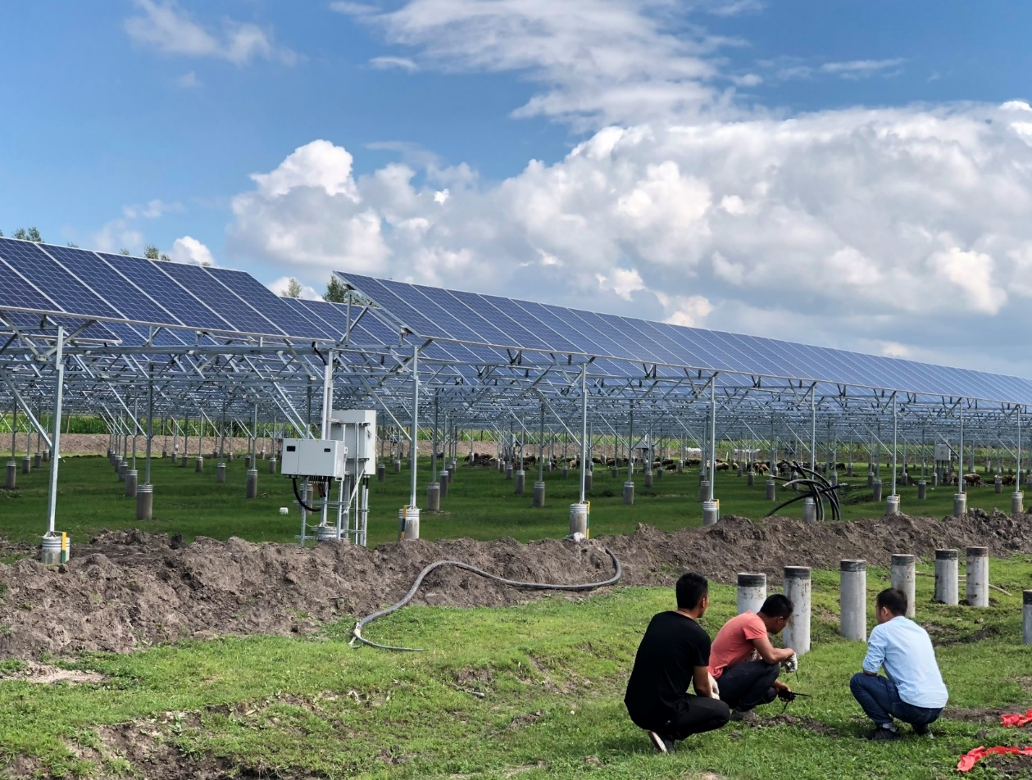
Innovative Implementation of Animal Husbandry, Planting and Breeding
Innovate the "photovoltaic + animal husbandry" planting and breeding mode in western China
An appropriate amount of PV roof sheep sheds can be built according to the actual planting and breeding needs. Small heating facilities using PV power can help sheep survive the winter.
In 2016, it helped poor areas in Hainan Prefecture, Qinghai Province to build a 100MW "intelligent photovoltaic + efficient animal husbandry" to get rid of poverty and become rich.
In 2017, innovative projects were replicated in Inner Mongolia Autonomous Region and Ningxia Hui Autonomous Region, and were highly praised by local governments and herdsmen in western China.

Slide 18
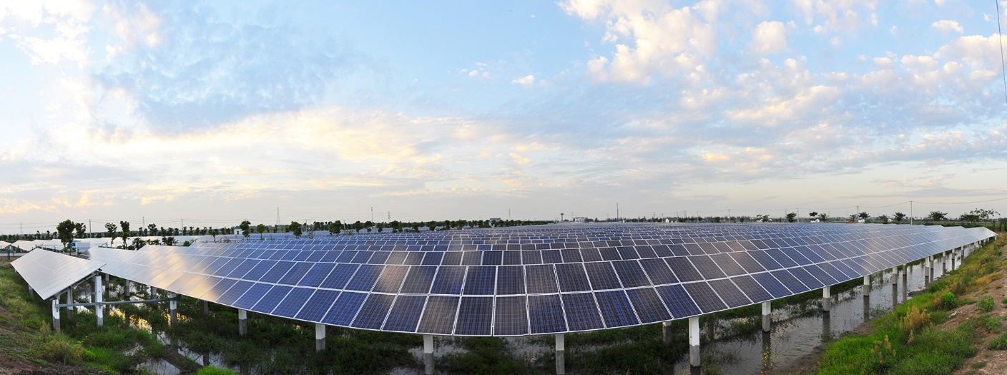
Innovative Implementation of “Complementation of Fishing and PV”
The innovative construction of PV farms in ponds has brought tangible benefits to fish and crab farming. Placing PV modules above fish ponds will not affect aquaculture of fishermen, as crabs, Australian freshwater crayfish and fish all like shade. Reasonable and optimized design of PV modules can realize the complementary advantages of fisheries and PV farms.
The annual net profit per mu reaches 22,500 yuan. On October 15, 2016, an expert group from 18 ministries and commissions conducted an on-side demonstration and unanimously believed that "complementation between fishing and PV farms" is an efficient and feasible new agricultural breeding mode.

Slide 19
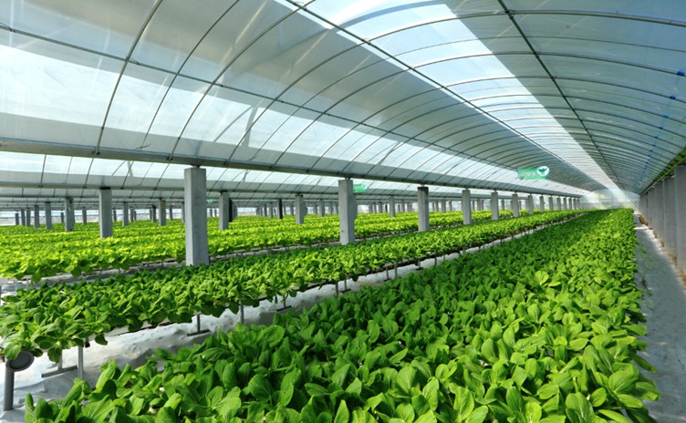
Innovative Implementation of Characteristic Agriculture
The innovative project can help build village-level "PV farms" in saline-alkali land and desert areas. Without requiring land improvement costs, it can increase the benefits of poverty alleviation.
We innovate the "PV farm + soil-free cultivation" technology, and erect a plastic film ceiling with the photovoltaic bracket, which greatly reduce the land area and greenhouse cost of traditional agricultural greenhouses. We adopt the nutrient solution soil-free cultivation technology to plant pollution-free vegetables, with per mu yield hitting over 5,000 yuan in net profit, equivalent to the per mu yield of PV power generation.

Slide 20
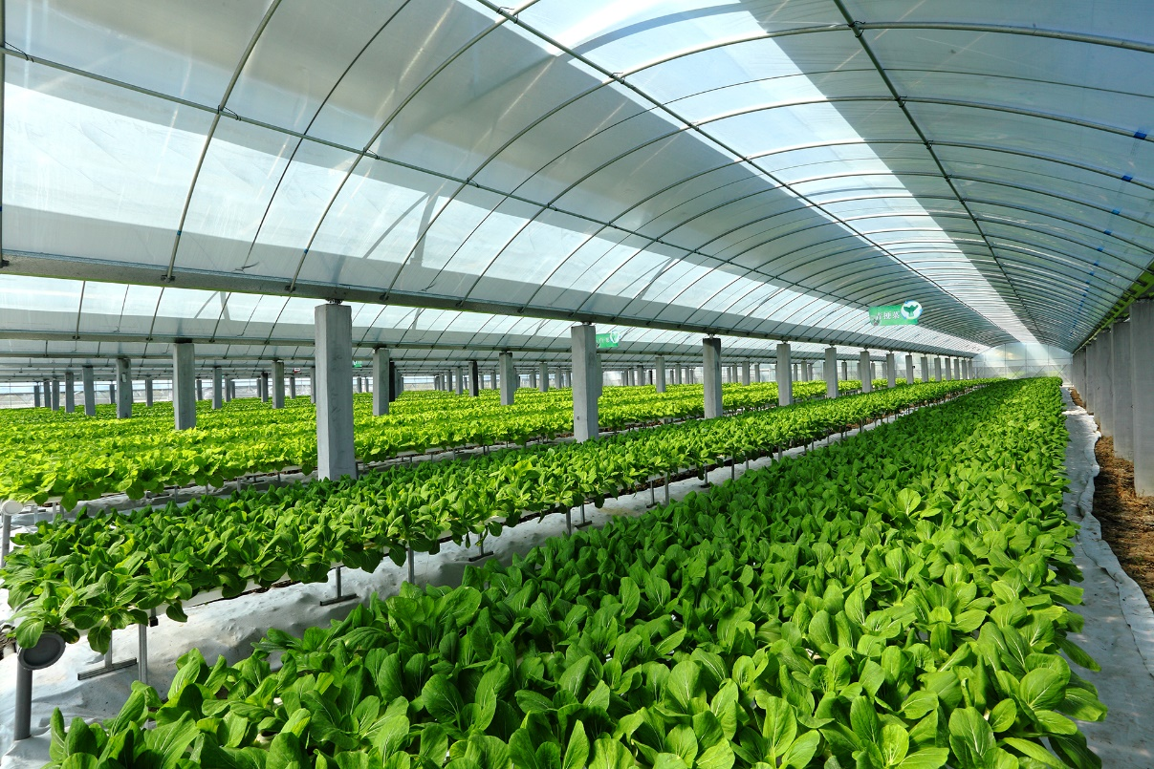
Greenhouse PV Integration
This part takes the form of agricultural greenhouses, called a multi-span greenhouses. There are guiding gutters between the greenhouses to collect rainwater and drain it away. The keels of the greenhouses adopt a steel pipe structure, which borrow a part of the PV column foundation. This arrows for cost saving and the integration of the greenhouse and PV facilities.
All crops employ the soil-free cultivation technology, which can well solve agricultural planting the problem of in areas with poor soil quality.
Soilless cultivation method: It is a cultivation method that uses pipeline nutrient solution for irrigation. It can artificially create a good rhizosphere environment to replace the soil environment, and effectively prevent the physiological obstacles caused by soil continuous cropping diseases and soil salt accumulation, and fully meet the crops’ needs for mineral nutrition, water, gas and other environmental conditions. The basic materials for cultivation can be recycled, so it has the characteristics of water saving, fertilizer saving, labor saving, high yield and high quality. Since the photovoltaic panels block part of sunlight, we choose crops that do not require strong light to grow, such as green vegetables, spinach, cabbage, mushroom, Agaricus, and Morchella, and have a dedicated seedling area.

Slide 21
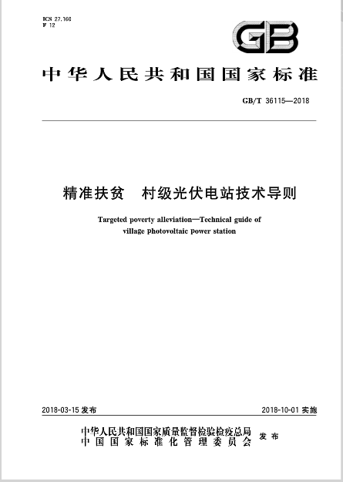
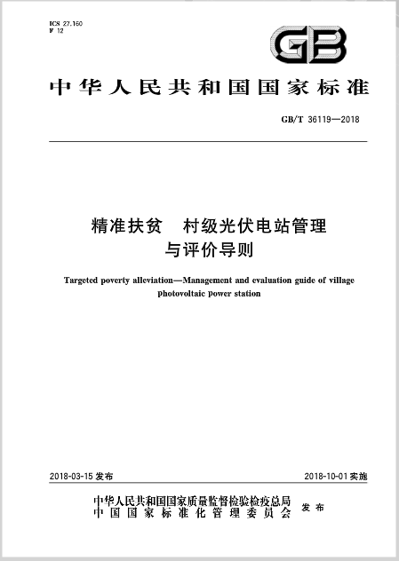
Participation in the Development of National Standards
The National Standards Committee, the Poverty Alleviation Office of The State Council, the State Grid Corporation, and the China Electric Power Research Institute formed a working group for the preparation of national standards for "village-level PV power plant". As the main drafting unit, Talesun participated in the compilation of the "technical guidelines for village-level PV power plants" standard.
5.1. 2 Those who do not have the condition for independent construction of village-level PV power plants, and meet the requirements of targeted poverty alleviation may adopt the multi-village joint construction.
4.1.5 Village-level PV power plants should not change the nature of the land at the site, and should be combined with agriculture, forestry, animal husbandry and fishery.
4.5.3 The PV power plant combined with agriculture, forestry, animal husbandry and fishery should design the inclination and spacing of the square array reasonably according to the industrial situation.
On March 15, 2018, two national standards, "Technical Guidelines for Village-level PV Power Plants" and "Guidelines for Management and Evaluation of Village-level PV Power Plants" were officially released.

Slide 22
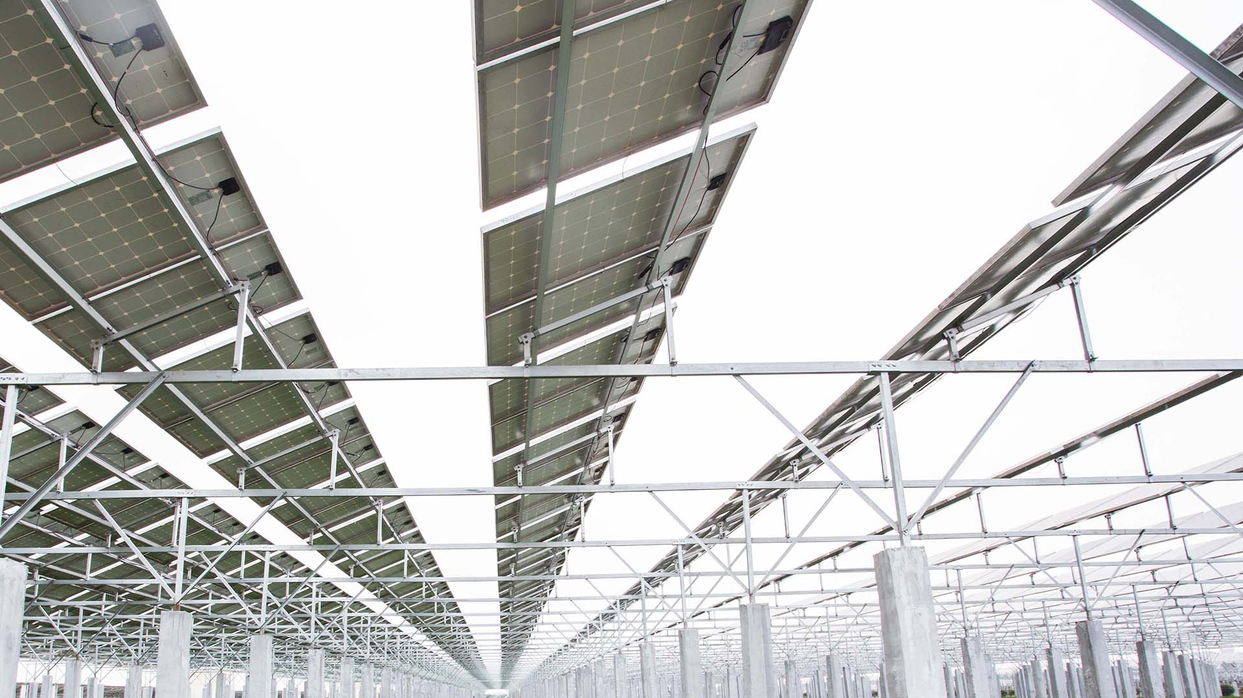
Agricultural PV Support Bracket
As an important part of the PV solar plant, the PV support bracket system carries the main power generation of the power plant. The choice of fixed structure not only directly affects the safety of operation process, the damage rate of components and construction investment, but also can reduce project cost and construction cost, further effectively reducing the later maintenance costs.
Talesun can customize each agricultural project to fully meet the specific environment of agricultural PV and other applications.

Slide 23
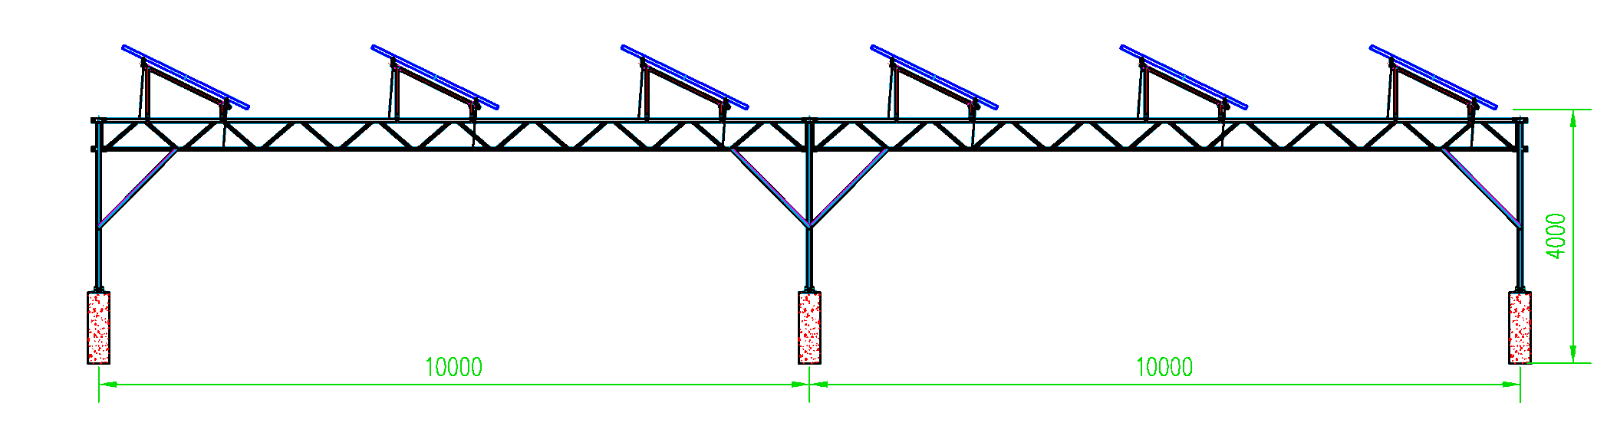
Technical Characteristics of Agricultural PV Support Bracket
1. Widen the spacing and raise the brackets so as not to compete with agriculture for space. The east and west piles are 10 meters apart. The north and south piles are 5 meters apart. The components are 4 meters from the ground. It fully meets the mechanized operation. The road and equipment can all be arranged under the power plant components, so the occupied ground area is greatly reduced.
2. Use the trusses skillfully to ensure the load-carrying capability, and make them solid, beautiful and practical. The 50cm high trusses are cleverly applied to connect the entire structure and meet the span demand of the whole power plant.
3. With freely adjusted handy sliders, the facility installation is convenient. The component brackets and trusses are connected with the sliders, enabling automatic adjustment of the array spacing of the components according to the latitude and light transmittance requirements. The light transmission is designed to reach more than 70%, to fully meet the lighting needs of crops.
4. Steel and aluminum are combined to make the facilities light at the top and heavy at the bottom, which is economical, environment-friendly and easy to recycle. The trusses and lower parts are of steel structure, and those above the trusses are made of aluminum alloy. The lower steel structure carries most of the weight. The brackets above the trusses are made of aluminum alloy, with small density and light weight. They are corrosion-resistant, beautiful and environment-friendly, and have a high recycling value 25 years later. The large-scale use of aluminum alloy brackets is a major feature of our company.
5. In addition to the transformation of the body, we have also upgraded the brain of the power plant, equipped it with an intelligent monitoring system, which can monitor the PV power generation and agricultural planting and breeding environment data in real time.

Slide 24
Contents
01
Talesun - Company Profile
02
Talesun - Introduction to Agricultural PV
03
Talesun - Agrivoltaics Projects

Slide 25
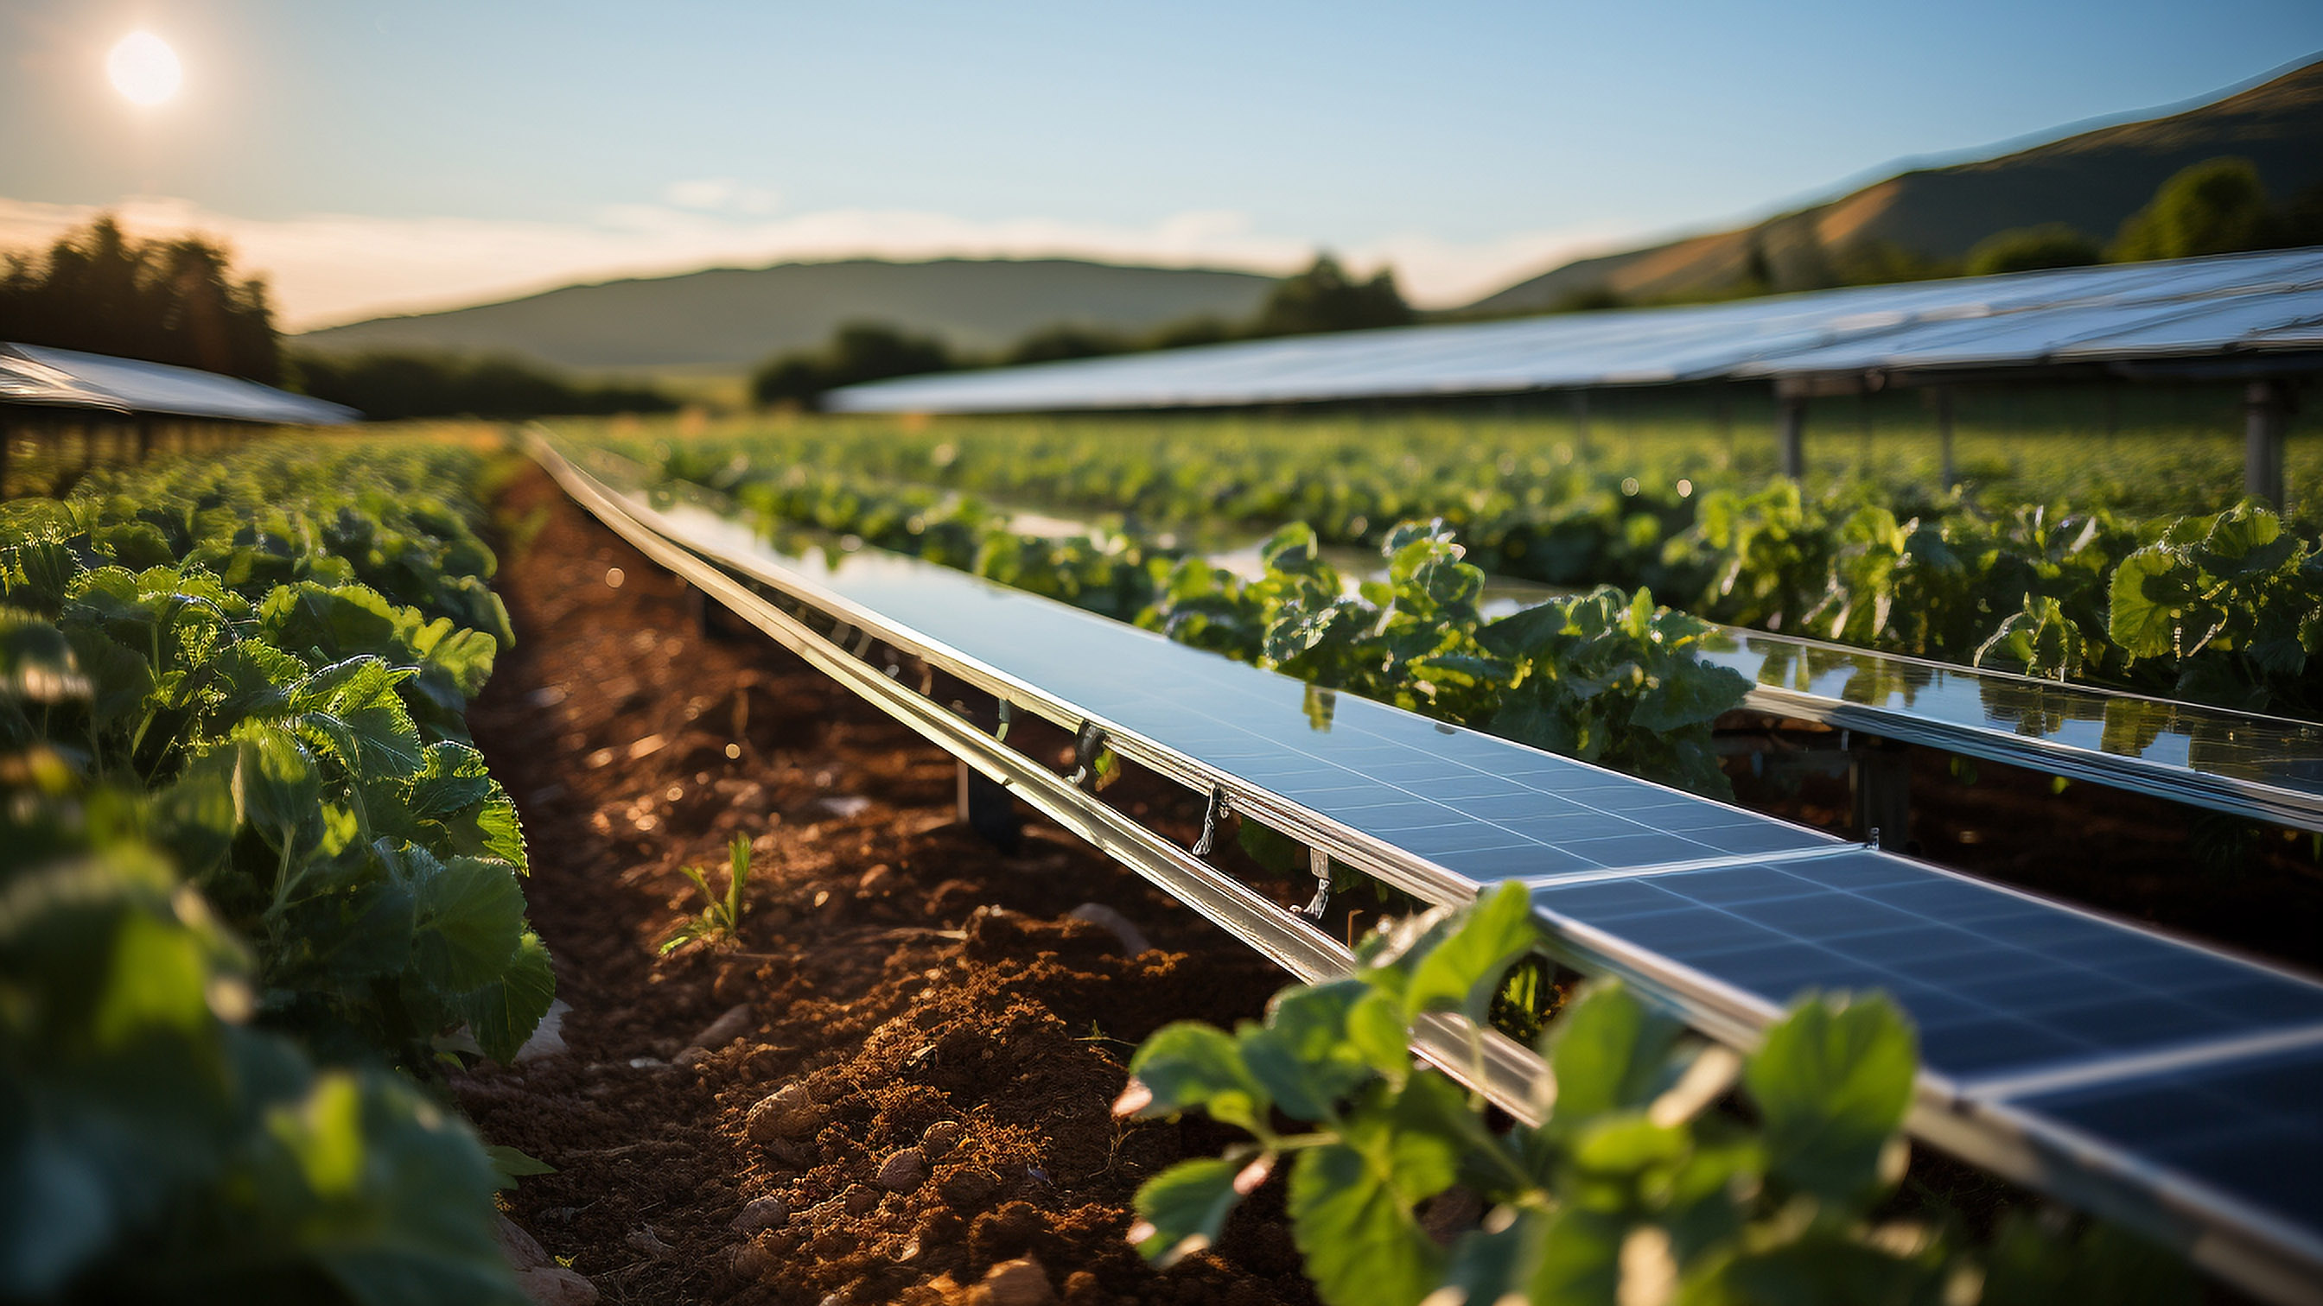
Talesun - Projects
Agriculture PV

Slide 26
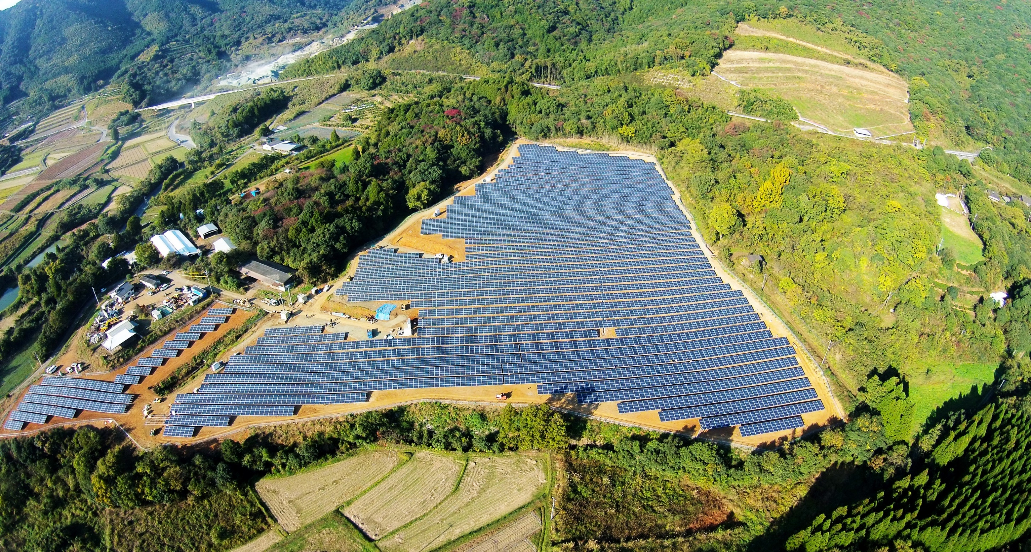
3.5 MW
Yamaga, Japan
Agri-voltaics

Slide 27
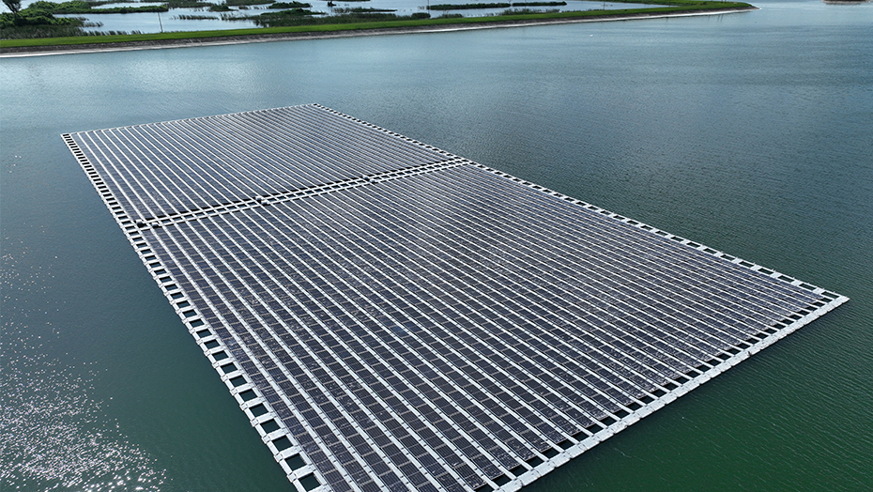
1 MW
Florida, USA
Floating Type

Slide 28
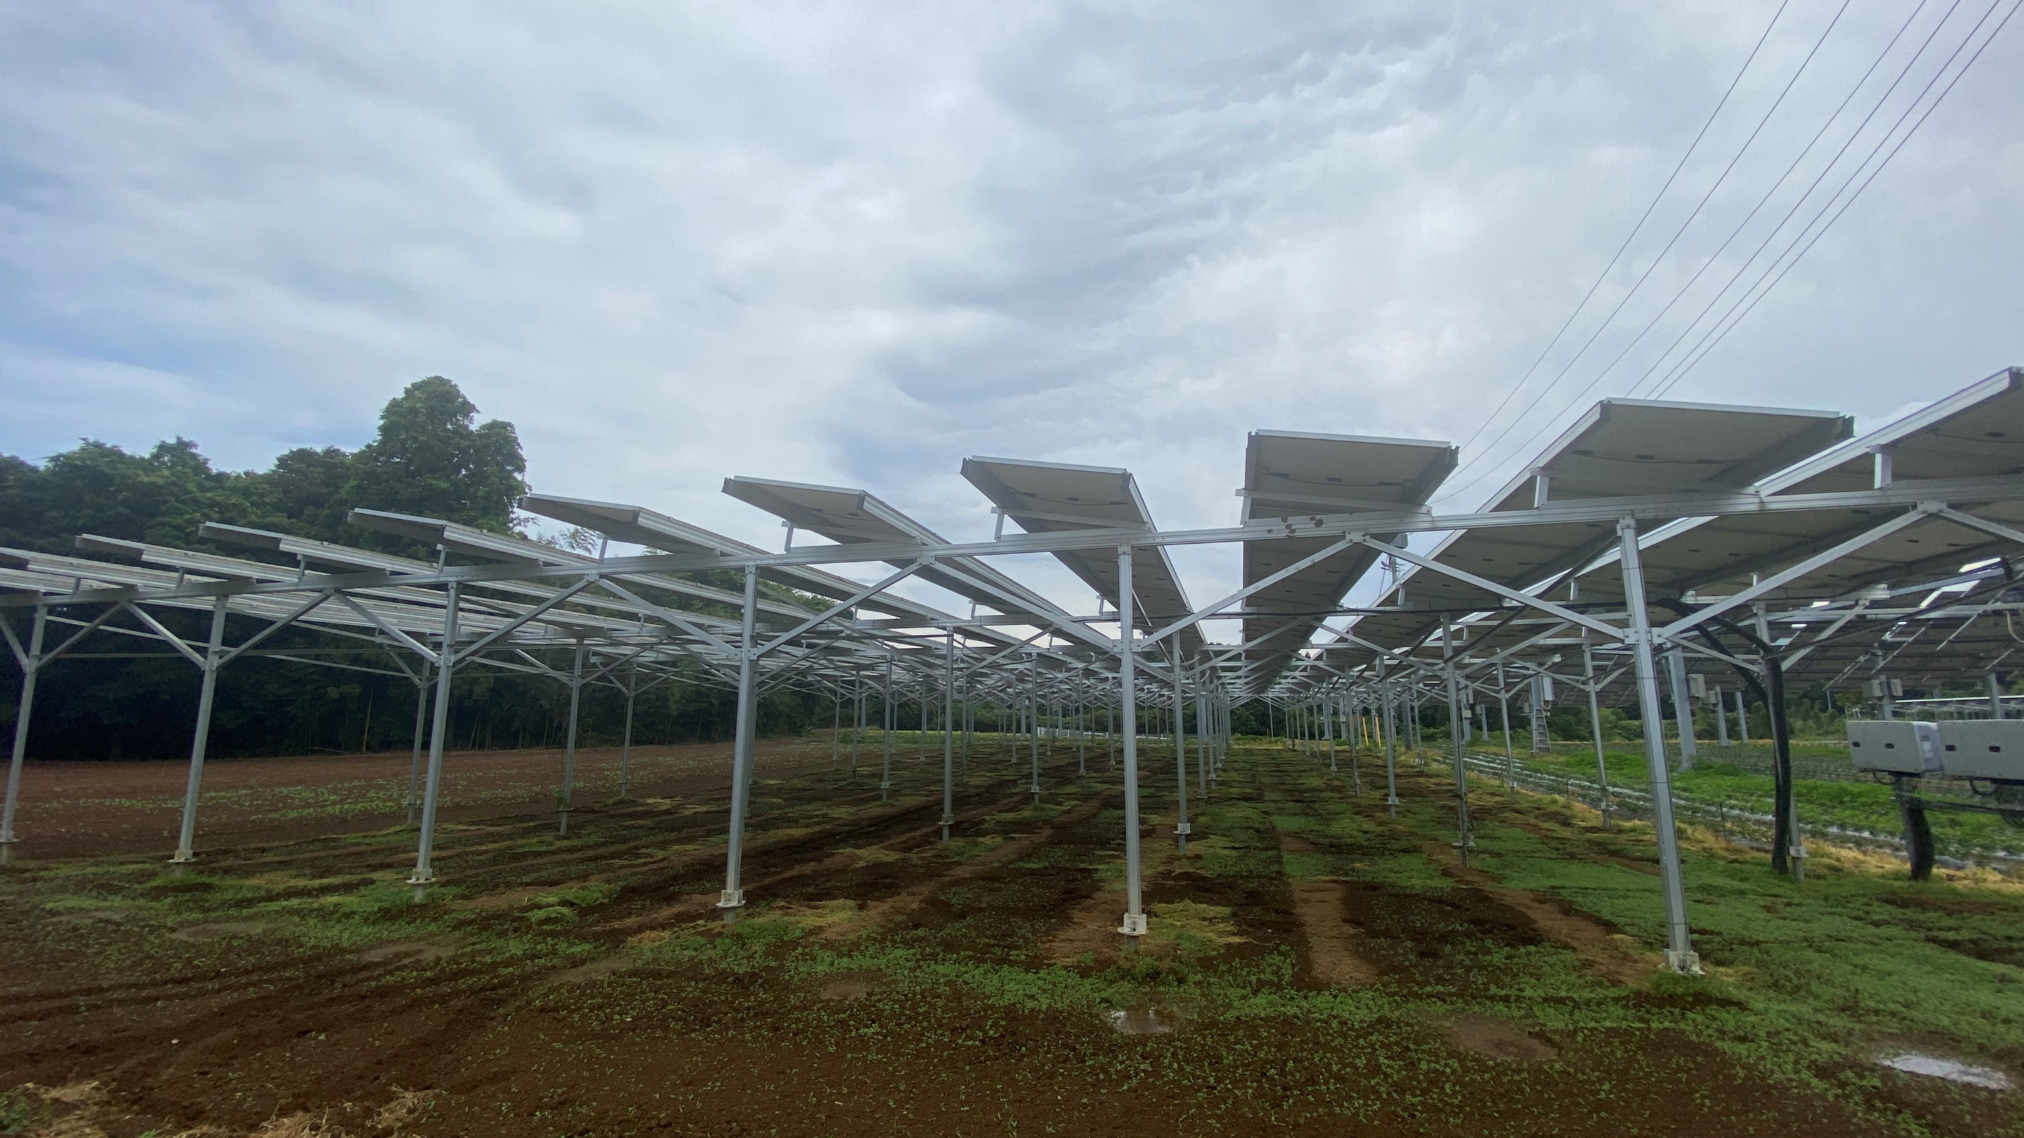
1 MW
Ibaraki, Japan
Agri-voltaics

Slide 29
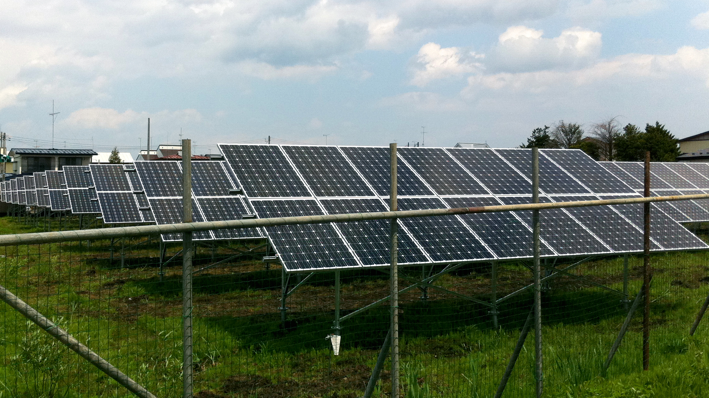
460 kW
Aomori-ken, Japan
Animal Husbandry
Agri-voltaics

Slide 30
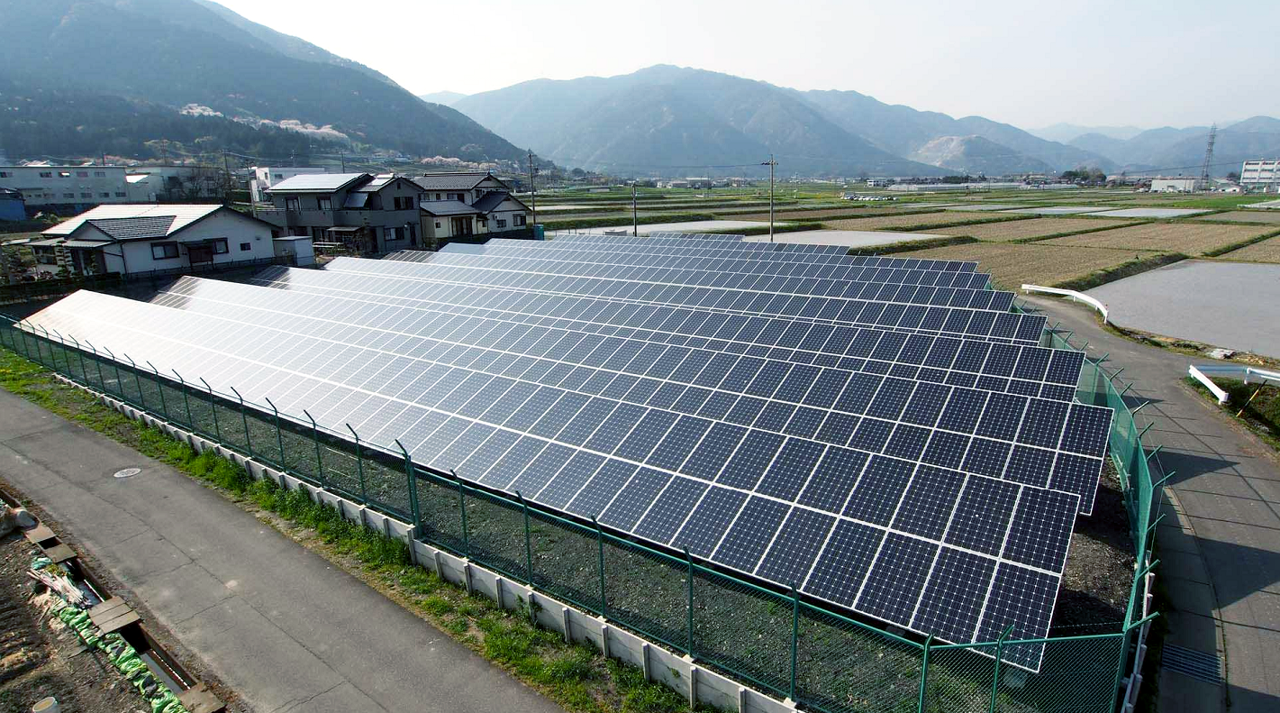
235 kW
Ibi-gun, Japan
Animal Husbandry
Agri-voltaics

Slide 31
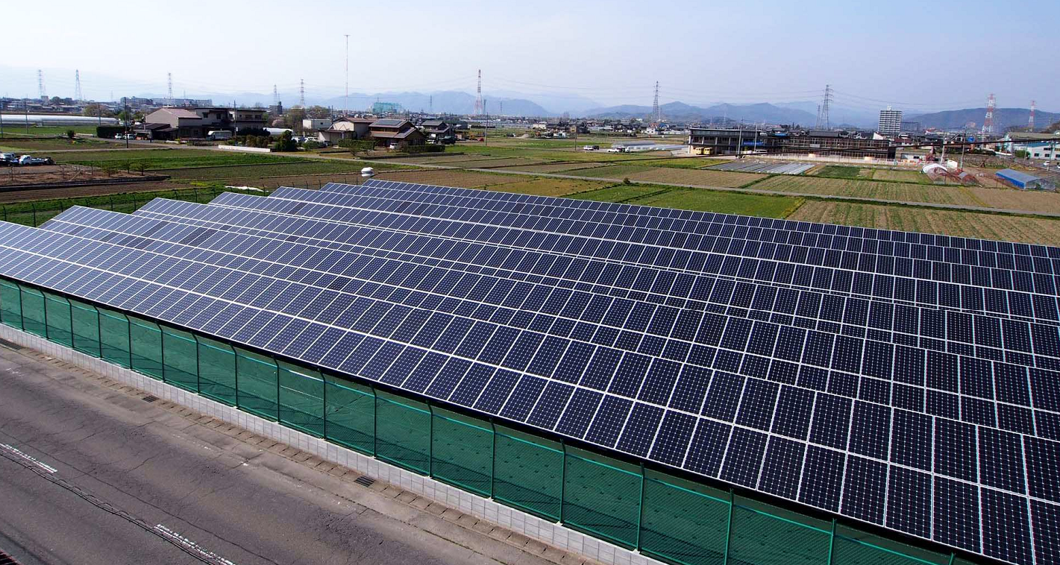
274 kW
Gifu, Japan
Animal Husbandry
Agri-voltaics

Slide 32
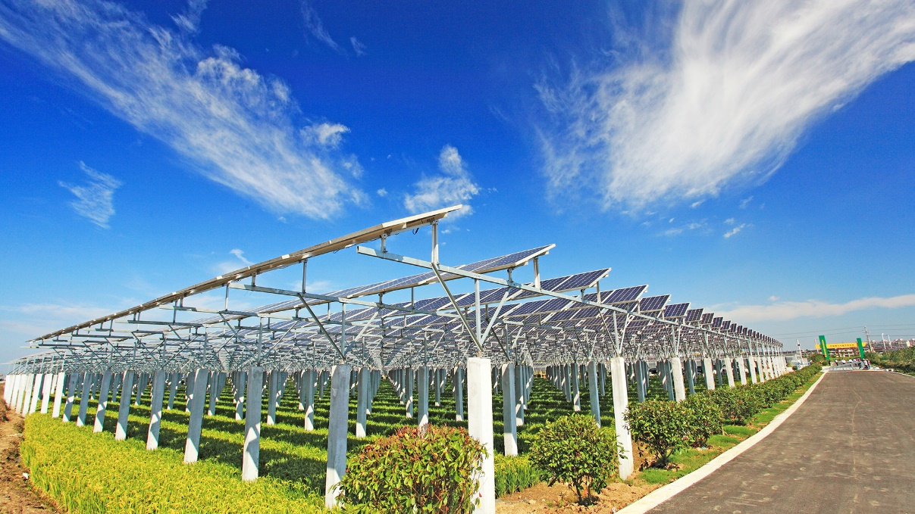
9.8 MW
Changshu Jiangsu, china
Agri-voltaics

Slide 33
20 MW
Hanshou Huanan , china
Agri-voltaics

Slide 34
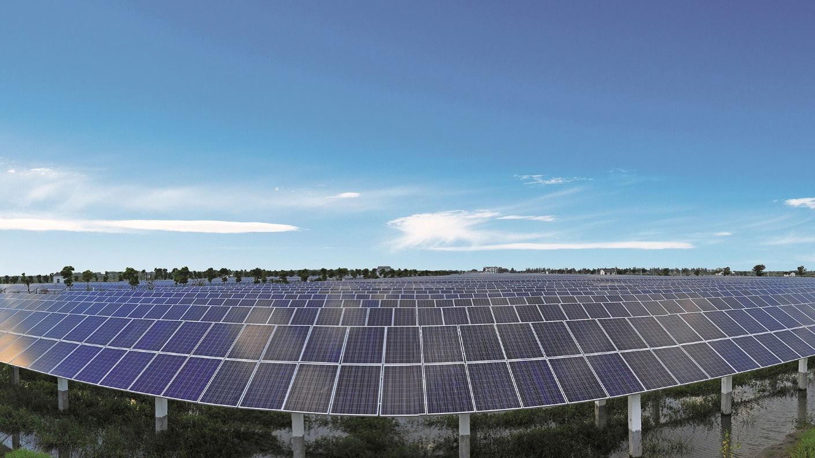
9.8 MW
Changshu Jiangsu, china
Fishery Agri-voltaics

Slide 35
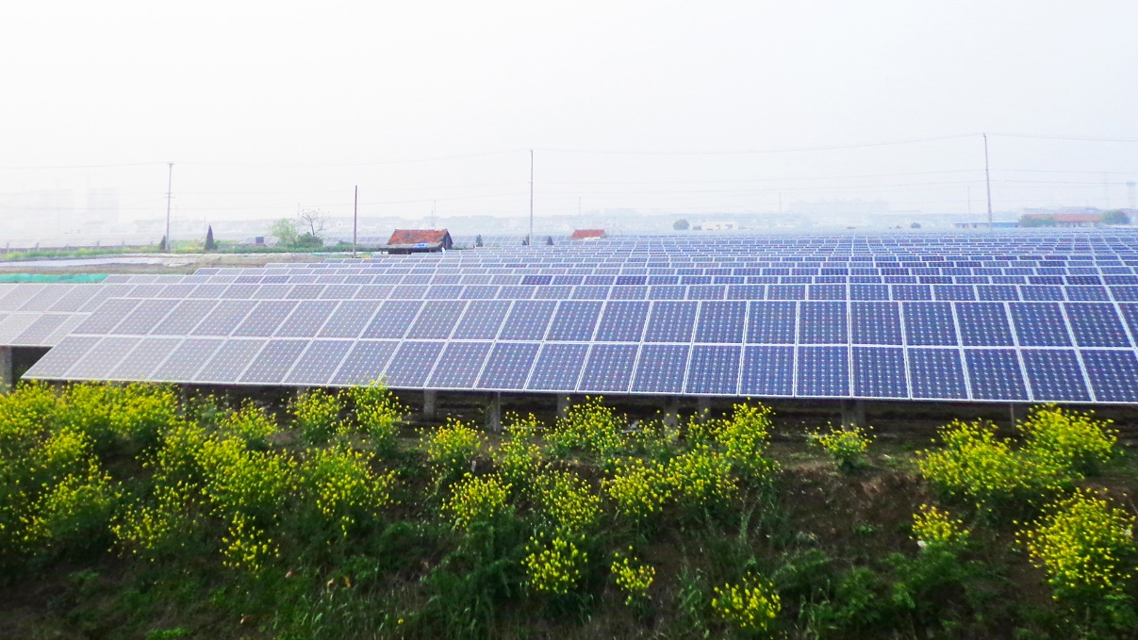
9.8 MW
Changshu Jiangsu, china
Fishery Agri-voltaics

Slide 36
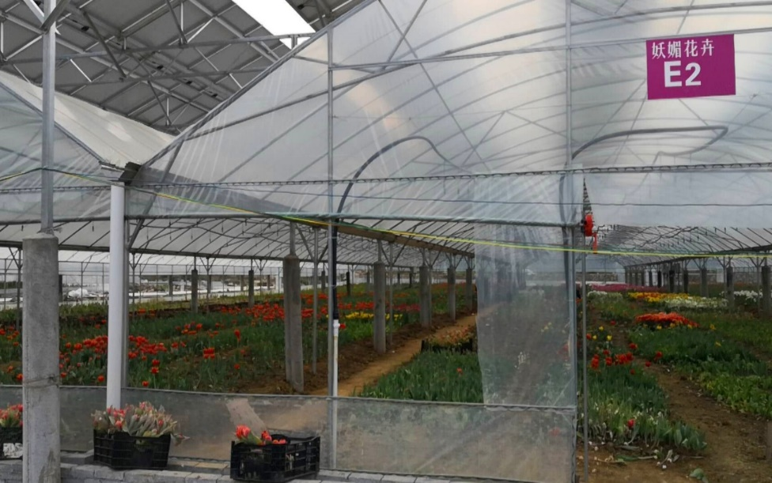
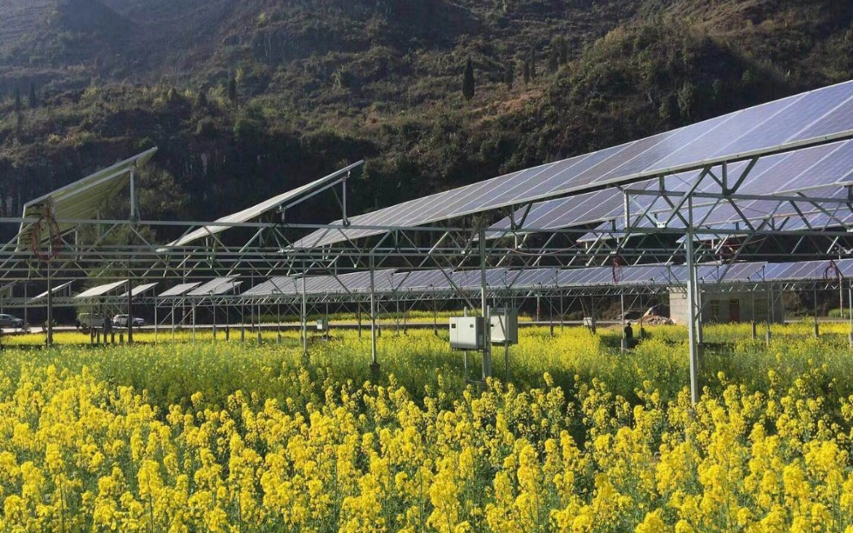
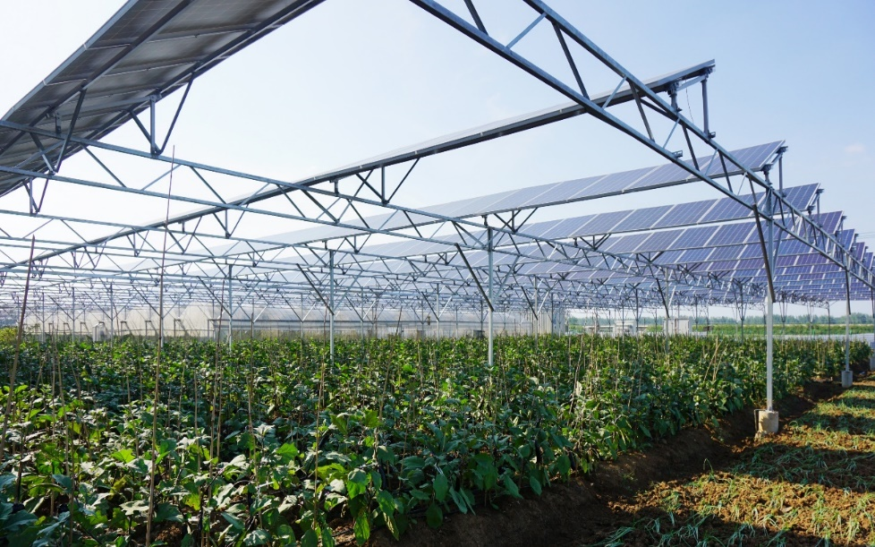
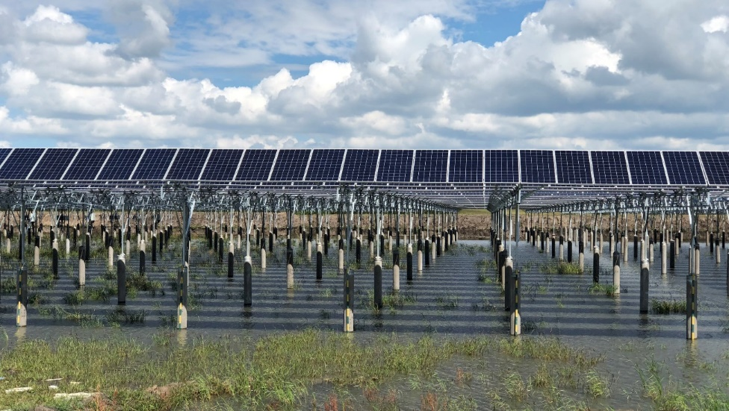
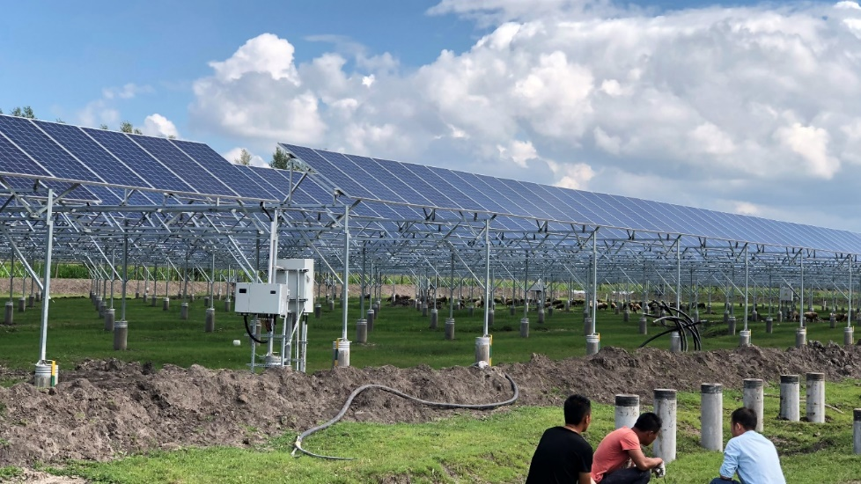
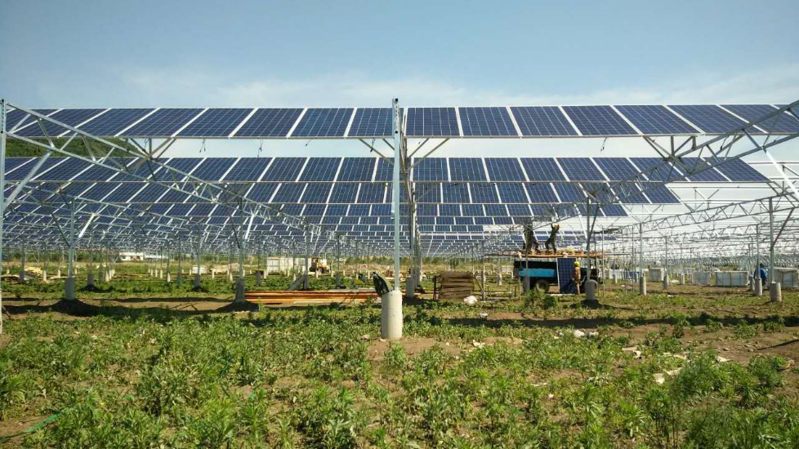
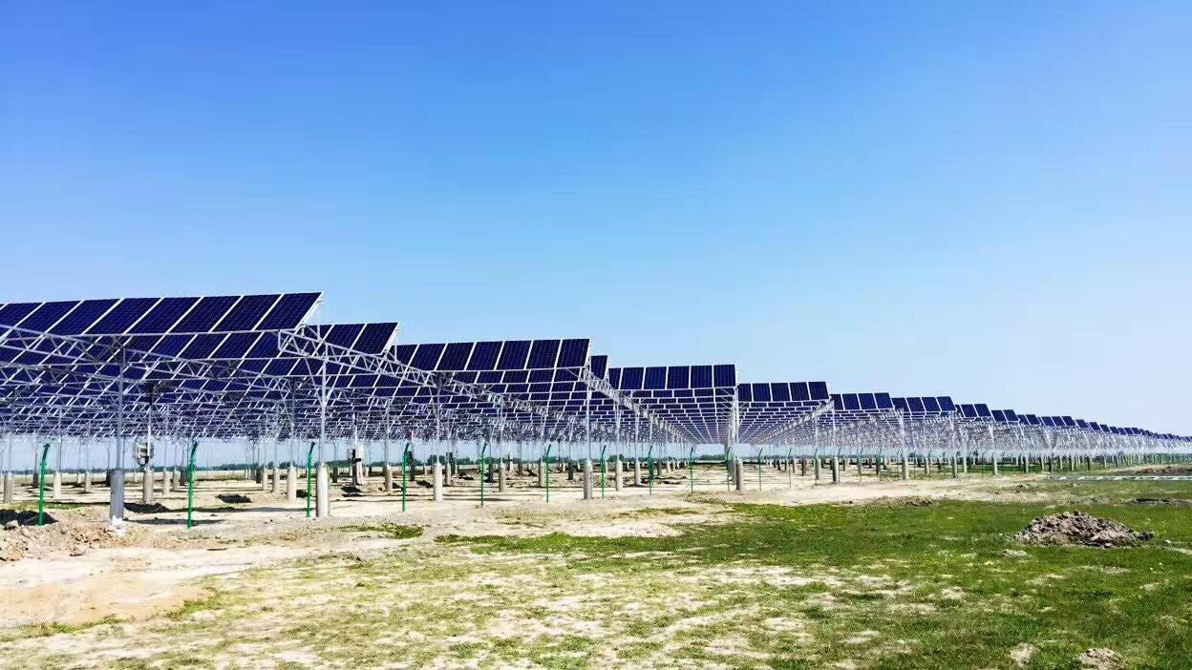
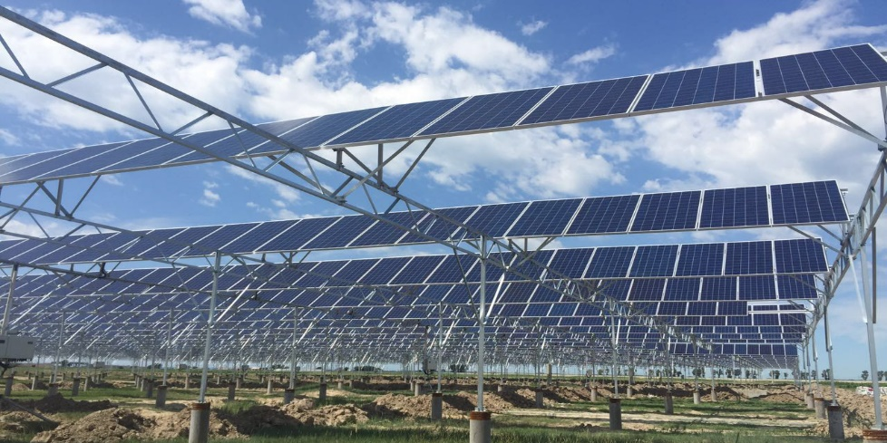

Zhenfeng, Guizhou (PV+ flower )
Ziyun, Guizhou (PV+ Canola)
Lingbi , Anhui (PV+ Chinese herbal medicine)
Qinggang, Heilongjiang (fisheries industry)
Qinggang, Heilongjiang (livestock)
TaoBei, Jilin Plantation
Zhenlai, Jilin (forest industry)
Mizhi, Shanxi (forest industry)
Shanyang, Shanxi(forest industry)

Slide 37
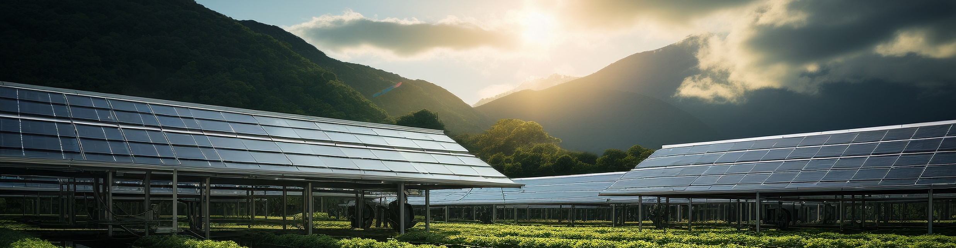
Talesun
The First Brand of Agricultural PV
Thank You！
www.talesun.com
sales@talesun.com

