Slide 1
Partnering for Innovation
Joseph Santarelli, MESc
Senior Advisor, Business Development

Slide 2
Notes:
Mitacs is a national, independent, not-for-profit organization that funds collaborative research between academia and industry.

Slide 3
Value for Mitacs Participant
Academic Participants
Satisfy intellectual curiosity with publication rights maintained
Alternative funding
Stipend vs. Research support funds
Apply skills/expertise to real world issues
Grow — or better harness — your network
Increase trainee/HQP employability
Partner/Industry
De-risk accessing and contracting talent
Leverage their budget
Access to expertise and equipment not available in-house
Tap into a national research network
Streamline talent pipeline

Slide 4
Mitacs Academic and Non Academic Partnerships
Host Partner Organization
Research Intern(s)
Home Academic Institution
Notes:
Three entities: Partner organization, Academic Institution and students/postdocs that are the living bridge between the two

Slide 5
Who is Eligible?
Interns
Undergraduates
Graduate Students
Postdoctoral Fellows
Recent Grads
International Students
Partners
For-profit Companies Not-for-Profits
Hospitals Municipalities
All Sectors
All Disciplines
Social Sciences and Humanities and STEM
*Interns do not need to be identified at time of application submission

Slide 6
Mitacs Accelerate
Collaboration between researchers and companies / NFPs / hospitals/ municipalities
Not a competition: applications are accepted at any time
Students/interns undergrad to post doctoral
Research
Answer a question relevant to the partner & broader research community
Decision communicated between 6 - 8 weeks
All sectors & disciplines Small or large multidisciplinary projects
Success rate of over 95%
Intern spends minimum 25% of time spent at each site

Slide 7
Mitacs Accelerate Flavors
Accelerate Flexible Funding Models
$10K or $15K per term/intern (partner contributes 50%)
Cluster funding model – enhanced partner leverage on larger projects (45:55)
Indigenous Pathways– enhanced partner leverage (25:75)
Accelerate Entrepreneur
Student/Postdoc founded companies working with approved incubators. Trainee gets paid to do research for their start-up.
Accelerate International
Undertake a project with a for-profit company outside of Canada (with partner countries)

Slide 8
Mitacs Accelerate – Enhanced Funding Call
Enhanced funding is available to projects in:
Cleantech
Agriculture, Agri-food & Aquaculture
Digital (AI, ICT, Quantum)
Biomanufacturing, Biotechnology, and Life & Health Sciences.
Stipulations:
Deadline: February 9, 2024 or until supplies last
New applications only
Max 6 terms per intern with enhanced funding
Interns must be named at time of submission
Mitacs can assist with finding you an academic collaborator for the project

Slide 9
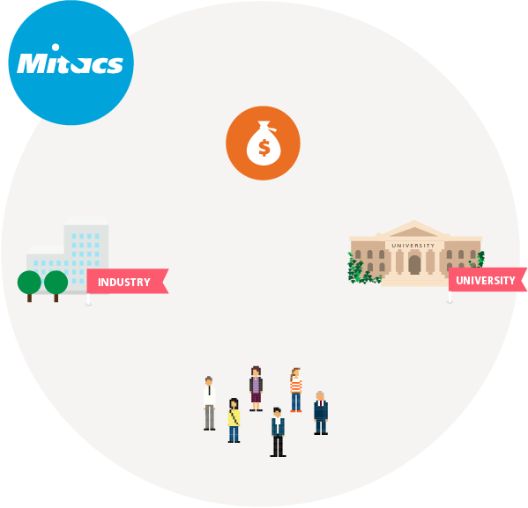
How it works: Flow of funds
The project costs only 50% to the partner
Access better leverage with larger projects
Total $ depends on size of project
Built on 4–6-month blocks of funding
Each block = 10K or 15K
Partner
Academic Inst
Project-related costs
Stipend
Blocks can be added according to the needs of the project

Slide 10
Mitacs Accelerate – Strategic Partnerships
Mitacs Accelerate can be used in conjunction with certain other partnership programs

Slide 11
Mitacs Accelerate – NSERC Alliance
Available for NSERC Alliance Advantage, applies to new submissions only
Eligible industry investments counts towards the global budget of the project
No additional industry cash is required to add on Mitacs funding
Funding:
NSERC recognizes either 1:1 or 2:1 (see NSERC guidelines)
Mitacs recognizes industry cash contribution
Example: Industry $30K (SME)
NSERC $60K (2:1)
Mitacs $30K
Total Budget: $120K
Streamlined process – one application – NSERC peer review

Slide 12
Distribution of Funds - Example
NSERC Alliance
2:1
Partner Cash
Mitacs Accelerate
1:1
Notes:
Each org does their own normal thing with the funds

Slide 13
Distribution of Funds – Example (2:1 w/4IUs)
$120K
4IUs
$60K
$60K
NSERC Alliance
Partner Cash
Mitacs Accelerate
$60K
2:1
1:1
$30K
$30K
Notes:
60-70% of global towards salary – for trainingpurposes

Slide 14
Development and Submission
Develop
BD works with PI to finalize the Mitacs supplemental form
PI simultaneously works with ORS to complete NSERC Alliance application
Sign-off
BD obtains ORS signature on Mitacs supplemental form
PI uploads signed Mitacs supplemental form to “other documents” section of NSERC Alliance Application
Submit
Projects can start at any time once approved per normal NSERC and Accelerate criteria
Review
Award
Once Alliance application is complete and supplemental form uploaded, PI submits full application to NSERC
PI sends Mitacs supplemental documents (budget, CV, etc) to BD to submit to Mitacs simultaneously
Standard Alliance review process
Notes:
Form 101 – Program name → Type of Call “Mitacs Accelerate” → Create
Contributions tab→ Add → Joint call funding partner
Budget page → BD name is the contact person “grantmanagement@mitacs.ca”
Find us in the list → use our BC location as HQ
Only Mitacs contribution goes into the cash contribution
Partner contribution is captured elsewhere

Slide 15
Business Strategy Internship (BSI)
Supports projects that fundamentally improve the function, capability, capacity, or potential of eligible Canadian Businesses or Community Partners
Examples: Commercialization of technologies, IP strategy creation, or accessing new and different markets
Award is valued at $10K – $15K per 4-6 month term
Open to for-profits, eligible not-for-profits, municipalities and hospitals
Partner pays only 50% of the project’s cost
Decision within 4-6 weeks

Slide 16
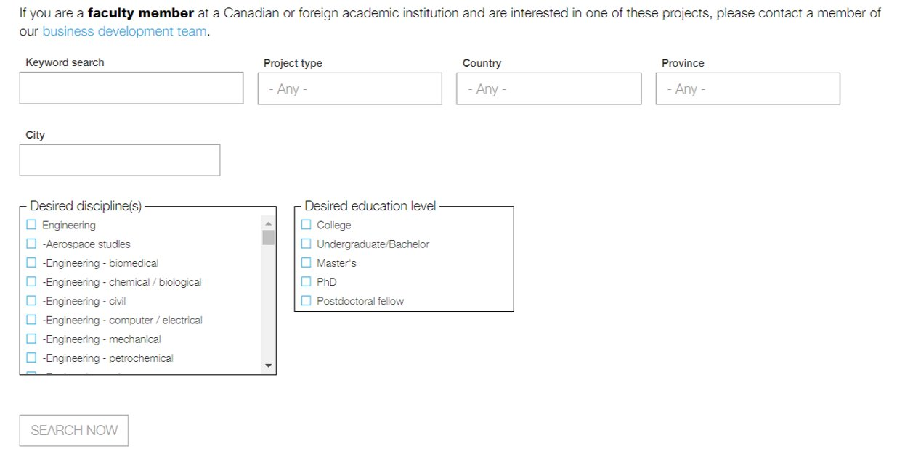
Mitacs Projects Seeking Academic Collaborators
Open Projects
Opportunities for Researchers (faculty or trainees)
Non academic partners looking for research collaborators are posted on Mitacs website
Open projects | Mitacs (link)

Slide 17
Mitacs Elevate
Collaboration between researchers and companies / NFPs / hospitals/ municipalities
Now Open Year Round
Supports postdoctoral fellows
Includes a professional develoment curriculum:
cross-disciplinary networking & peer-learning opportunities
prepares fellows for success as leaders in research & industry
Great option for PDF funding ($60K vs $45K)
Postdoc Fellowship
One or two year collaborative research projects
Open to academic institutions across Canada
Fellowship valued at 60K per year & costs only 50% to the partner

Slide 18
Mitacs Globalink Research Award
Collaboration between universities
Supervisor in Canada
Open to undergraduates to PDFs
University in Canada
Intern exchange
$6K
Any discipline
Intern
Supervisor abroad
No deadline
Univeristy abroad
12 to 24 week internship

Slide 19
Notes:
***This slide ↑ must accompany every presentation deck!!! Please MAINTAIN this slide.
DO NOT DELETE ☺

Slide 20
Contact information
Joseph Santarelli, MESc
jsantarelli@mitacs.ca

Slide 21
Mitacs Accelerate – SSHRC Partnership Grants
Eligible for PEG, PDG, PG-2, IG
Eligible partner cash in SSHRC project budget can be recognized by Mitacs for trainee support
Streamlined: Applicants can use eligible partner cash in SSHRC budget towards Mitacs trainee support. SSHRC and Mitacs applications submitted to each agency and are evaluated separately but reviewed simultaneously
Mitacs internal review
SSHRC standard review
Retroactive: Current SSHRC PG holders can apply for Mitacs using available partner cash from PG for trainee support

